Slide 1
PROJECT
BoulderDash

Slide 2
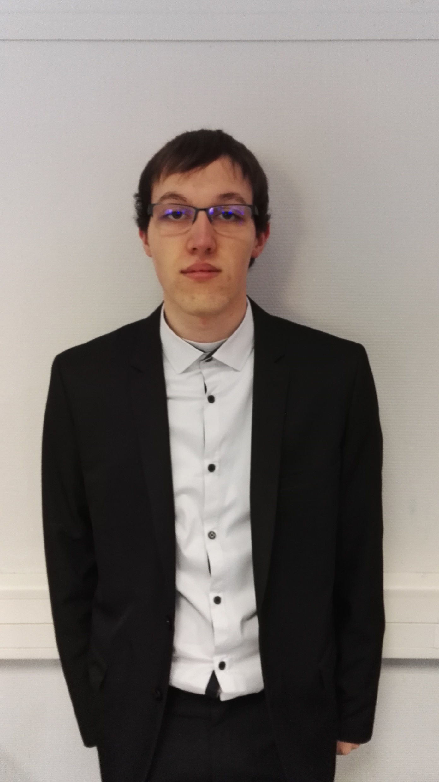

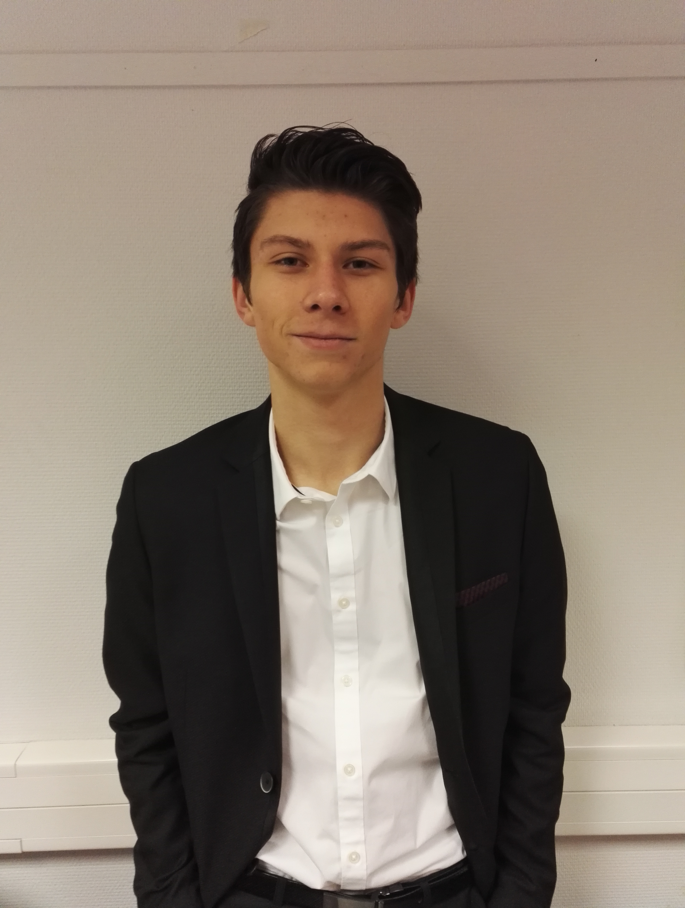
Group presentation :
Caron Alexis : Fritsch Florian :
Descamps Anthony : Libessart Dimitri :

Slide 3
Summary :
Context of the project
Program of the week
MVC
Unit tests
Demonstration
Encountered problems
Improvements
Conclusion

Slide 4
Context of the project
Design 5 levels of the game BoulderDash.
Write the code of the game with the Java Programming Language.
Create a Package Diagram, a Component Diagram, a Sequence Diagram and five Class Diagrams (for Model, View, Contract, Controller and Main).
Create unit tests and report.

Slide 5


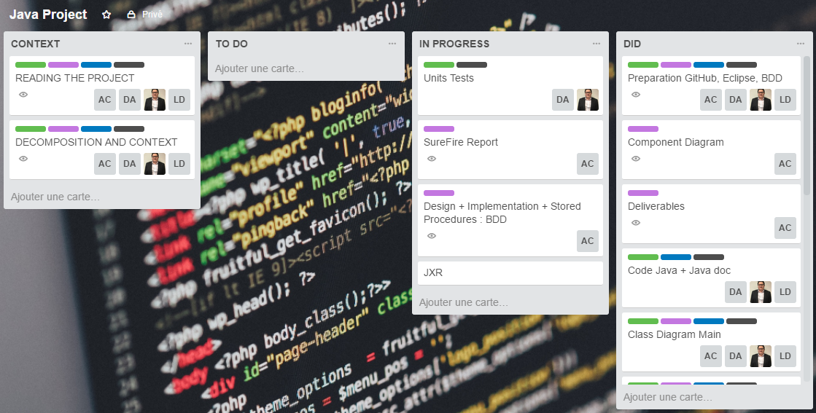
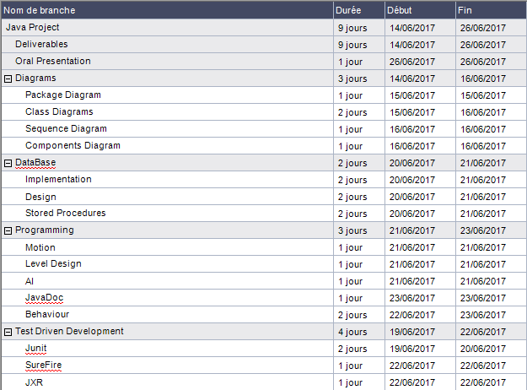
schedule
We used Trello
We made a gantt chart

Slide 6
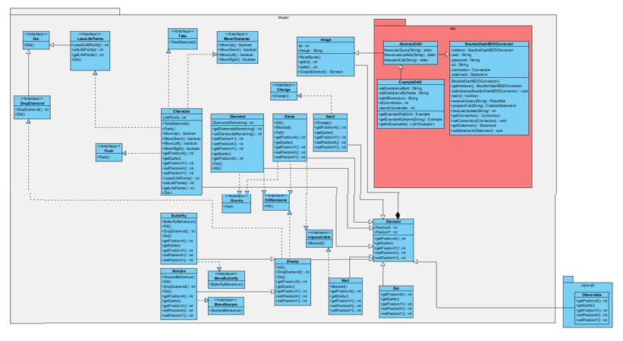
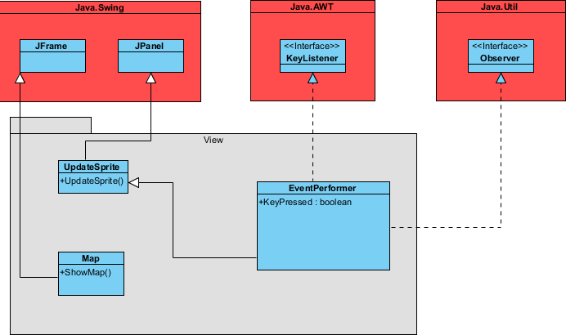
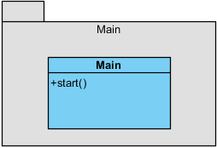
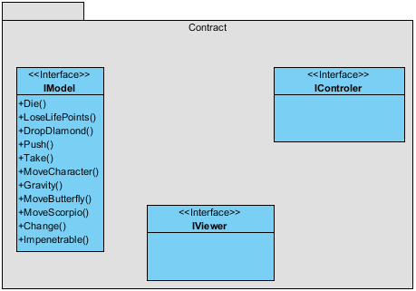
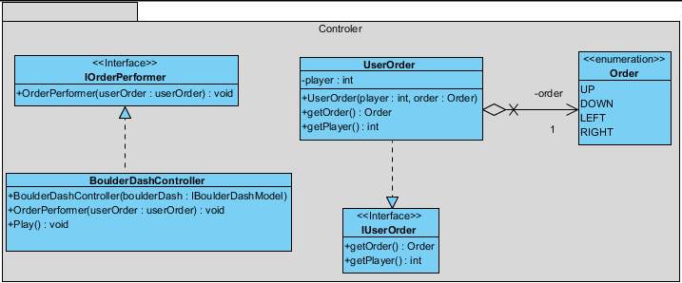
Class Diagram
Model
View
Main
MVC
Contract
Controller

Slide 7
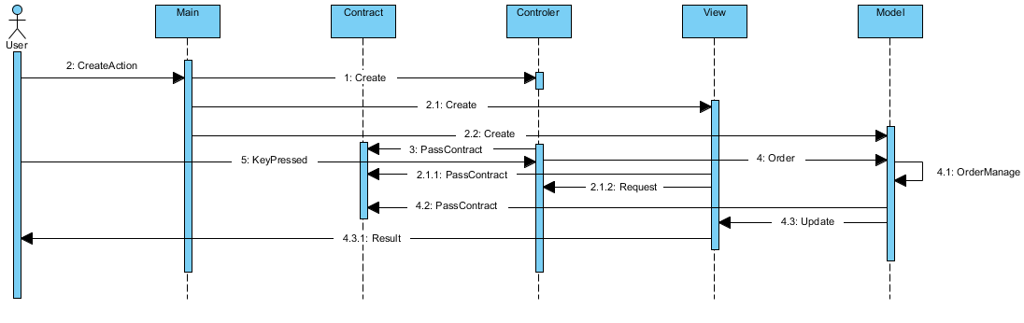
Sequence Diagrams

Slide 8
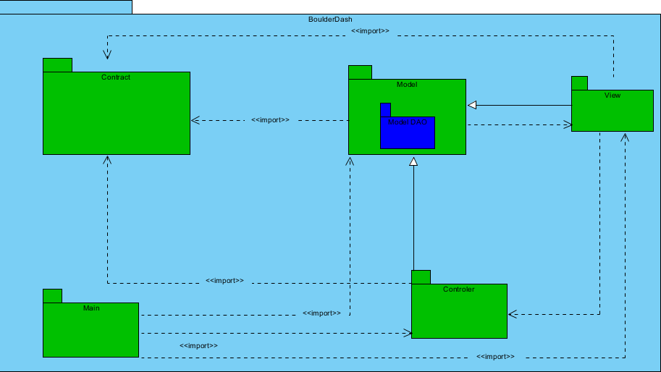
Package Diagrams

Slide 9
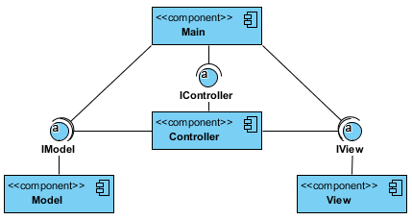
Components Diagrams

Slide 10
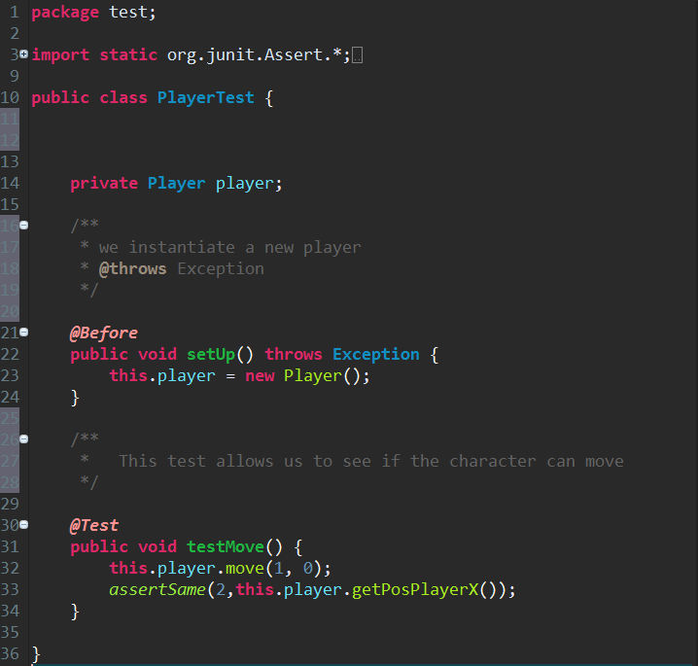
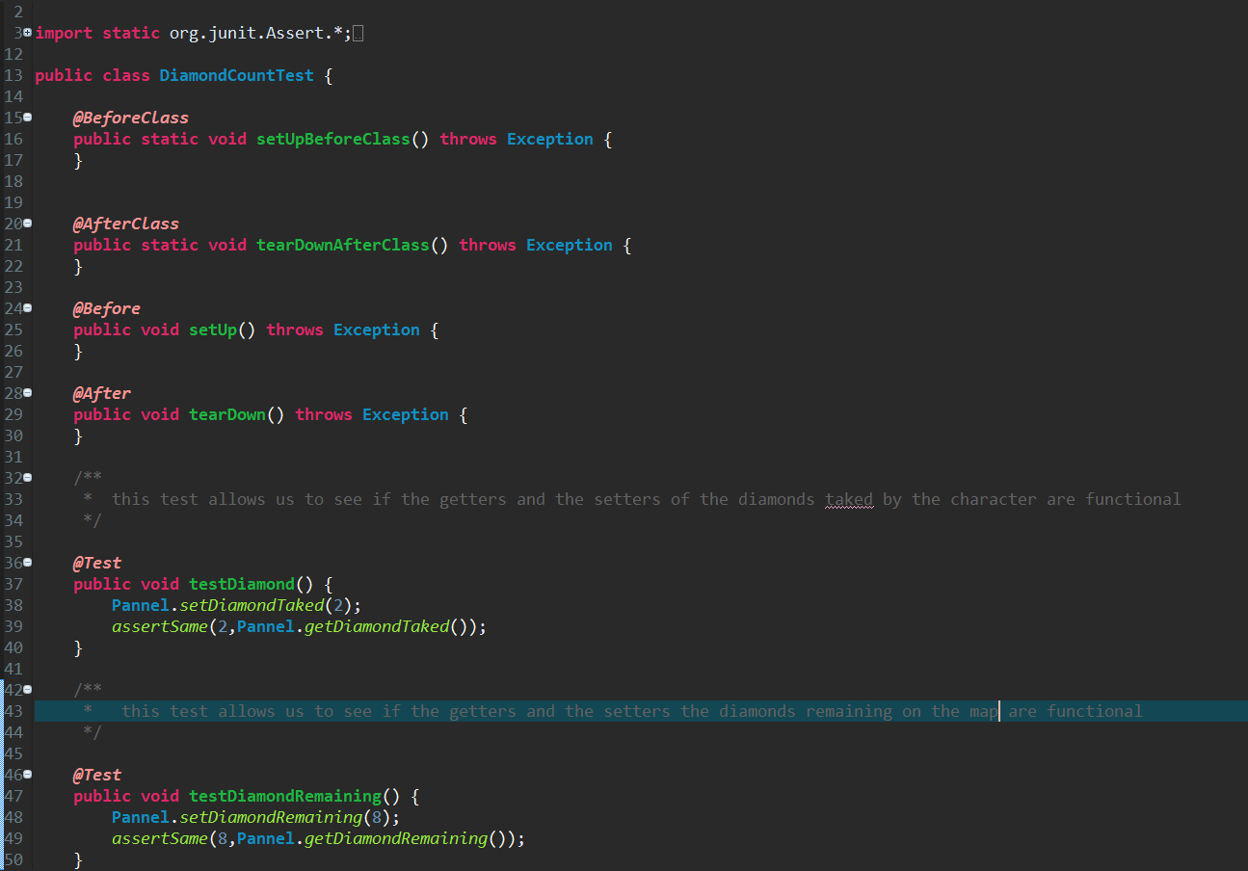
Unit test
Test if the game is functional
: This test allows us to know if the character moves well in the map
This test allows us to know if the assessors work perfectly :

Slide 11
Demonstration
→ Sand
→ Dirt
5 levels are functionnal
2 monsters with differents behaviour
The character can move and he can destruct the sand by advancing
The character is blocked by the walls and the rocks
The character can push the rocks but not if the rock is blocked by another element
The rocks and the diamonds can fall
The character is killed by the rocks and the diamonds when they fall
The character can take the diamonds
The monsters are blocked by walls, sands and rocks
The monsters can’t push the rocks
The monsters can’t dig
The game is over when the character die
The game is over when all the diamonds are taked by the character

Slide 12
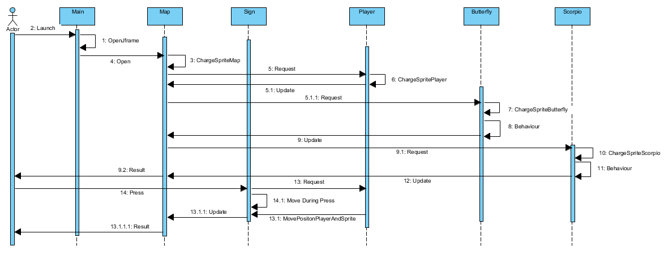
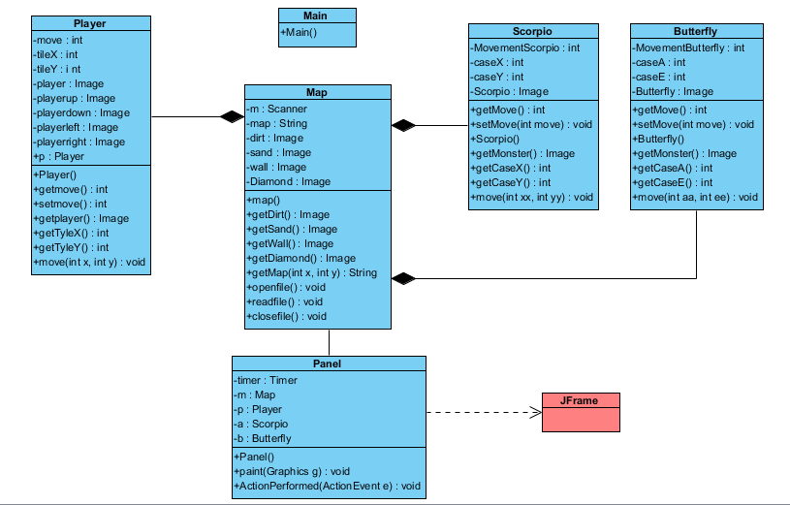
Encoutered problem
MVC
Github
Database
Unit tests and SureFire rapport

Slide 13
Amelioration point
MVC
Connexion to the database
More unit tests
Add more functionnalities in the game

Slide 14
Conclusion
The project was difficult
The game is functional
Improvements are possible

Slide 15
Question ?

